Slide 1
Assignment deadlines reminder
March 31st – web service programming tutorial (10%)
15% - Hot topic study journal – 3 tasks
Task 1 – March 26th
Task 2 – April 2nd
Task 3 – April 9th
10% - Exercises - Case study – April 16th

Slide 2
COMP3017 Service Computing

Slide 3

Module Seven: Hot topics in Service Computing - Cloud -

Slide 4
Topic 1: Cloud Computing Overview

Slide 5
Review

Slide 6
Cloud computing definition
Cloud computing is the delivery of different services through the Internet, which includes tools and applications like data storage, servers, databases, networking, and software.

Slide 7
Cloud computing definition (2)
Cloud computing is a general term for anything that involves delivering hosted services over the internet.
These services are divided into three main categories or types of cloud computing: infrastructure as a service (IaaS), platform as a service (PaaS) and software as a service (SaaS).

Slide 8
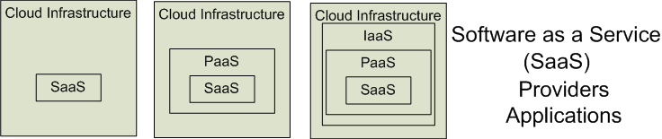

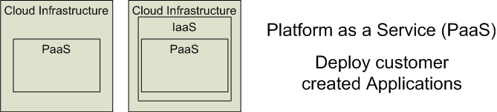
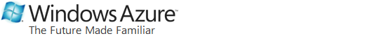
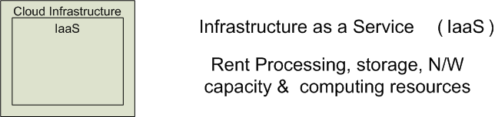
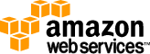

Cloud Service Models
Software as a Service (SaaS)
Platform as a Service (PaaS)
Infrastructure as a Service (IaaS)
SalesForce CRM
LotusLive
Google App Engine

Slide 9
Cloud deployment models (1)
Public clouds
Provide their services on servers and storage on the Internet.
These are operated by third-party companies, who handle and control all the hardware, software, and the general infrastructure.
Clients access services through accounts that can be accessed by just about anyone.
Private clouds
Are reserved for specific clientele, usually one business or organization.
The firm's data service center may host the cloud computing service.
Many private cloud computing services are provided on a private network.
Hybrid clouds
A combination of both public and private services.
This type of model allows the user more flexibility and helps optimize the user's infrastructure and security.

Slide 10
Cloud deployment models (2)
Community cloud
It allows systems and services to be accessible by a group of organizations
It is a distributed system that is created by integrating the services of different clouds to address the specific needs of a community, industry, or business
The infrastructure of the community could be shared between the organization which has shared concerns or tasks
It is generally managed by a third party or by the combination of one or more organizations in the community
Multi-cloud
Employing multiple cloud providers at the same time
It’s similar to the hybrid cloud deployment approach, which combines public and private cloud resources
Instead of merging private and public clouds, multi-cloud uses many public clouds
Improves availability of the services – when one cloud fails, another is available

Slide 11
Who uses cloud?
The short answer is: everyone.
From your phone and your car to your smart watch and your favorite food delivery app, the cloud is everywhere.
But cloud computing is especially powerful for businesses
Companies use it for routine tasks like
data protection
software development
data analytics
disaster recovery
virtual desktops
server virtualization
customer-facing applications

Slide 12
Cloud Computing Characteristics
Essential Characteristics:
On Demand Self-Service
Broad Network Access
Rapid Elasticity
Resource Pooling
Measured Service
Other Common Characteristics:
Massive Scale
Resilient Computing
Homogeneity
Geographic Distribution
Virtualization
Service Orientation
Low Cost Software
Advanced Security

Slide 13
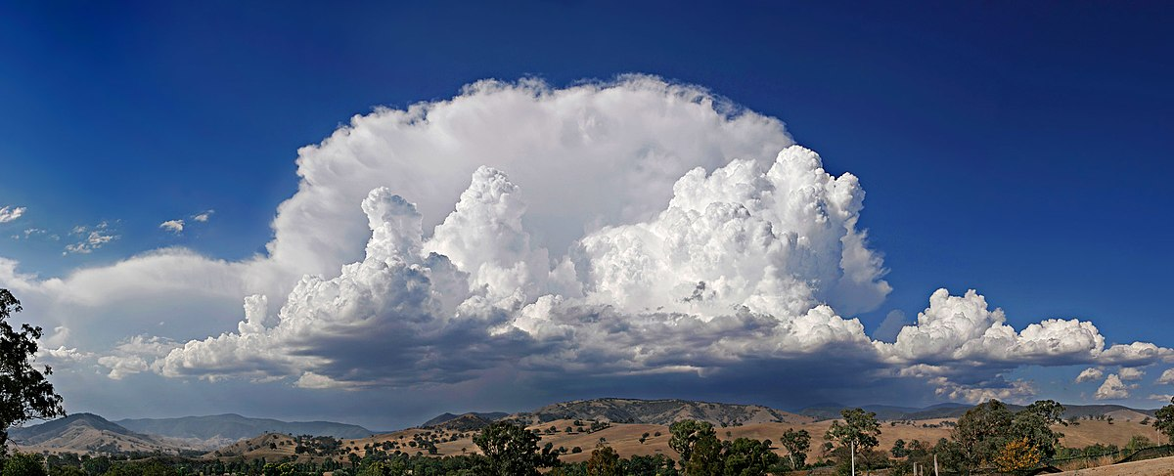
What is “cloud”?

Slide 14
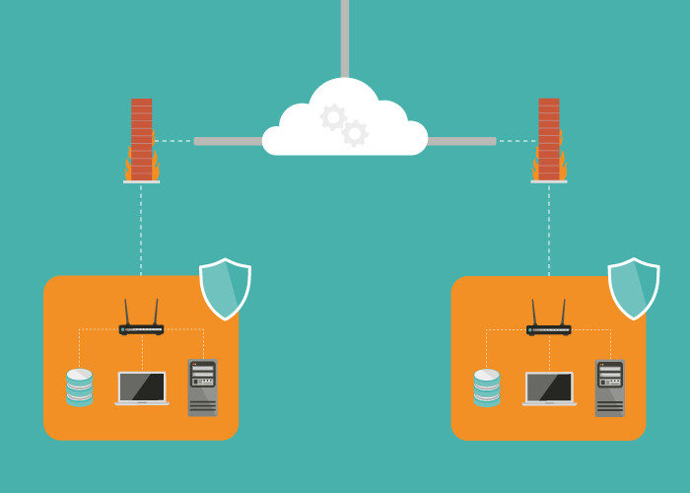
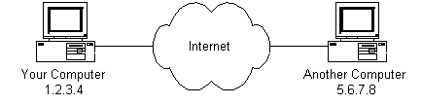
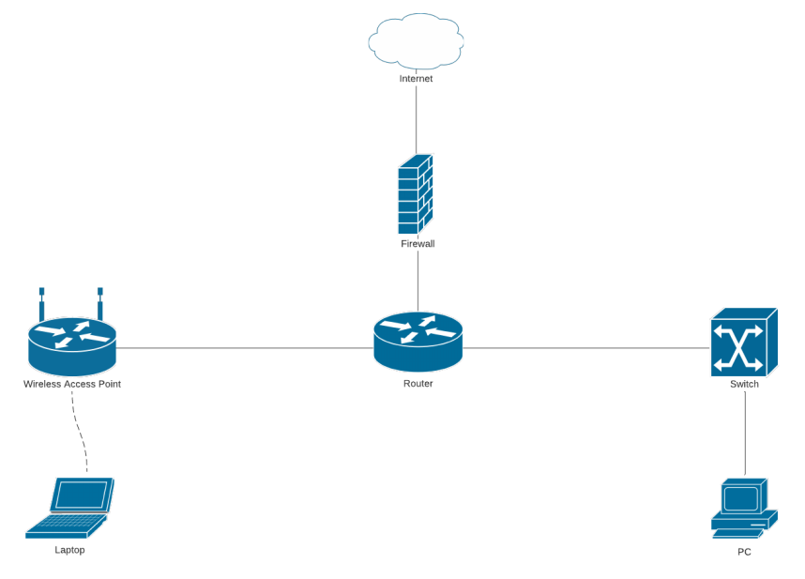
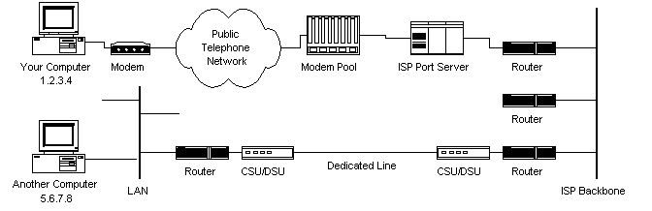
Cloud as symbol used to represent the Internet in these flow charts and diagrams?

Slide 15
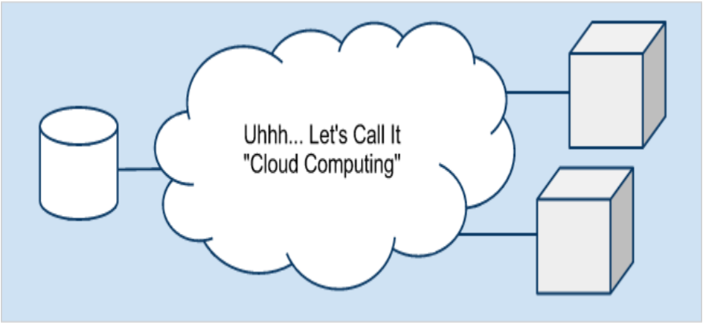
Cloud as a symbol of Internet in diagrams
One relevant quote " Cloud comes from the early days of Internet where we drew the network as a cloud... we didn't care where the message went- the cloud hid it from us " , Kevin Marks, Google Engineer

Slide 16
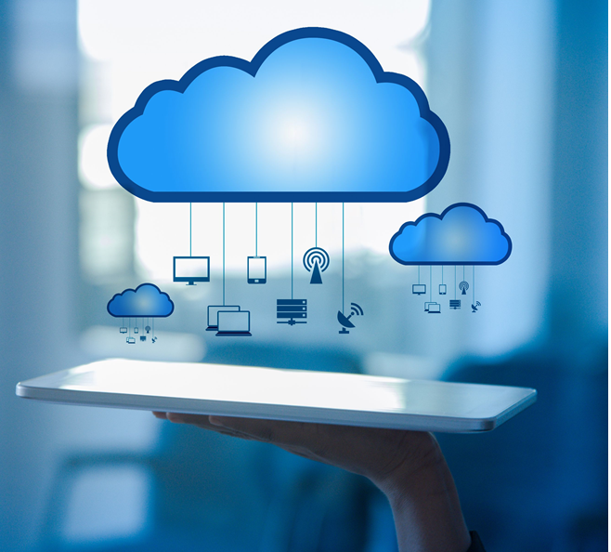
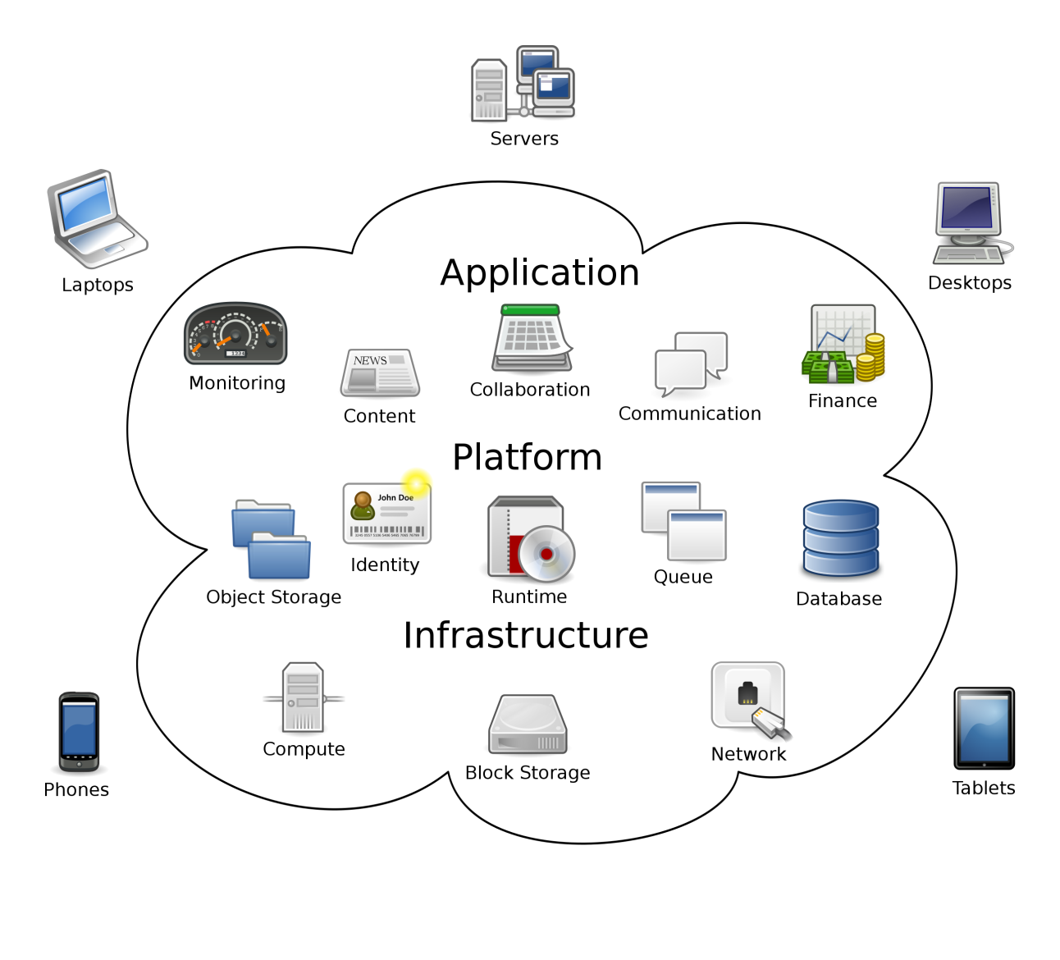
Cloud as a metaphor for virtual space
That virtual space in which our data and application are stored becomes the cloud —your data, work, and applications are available from any device with which you can connect to the Internet, anywhere in the world.

Slide 17
Evolution of cloud computing
These technologies contributed to the making of cloud computing:
1950s /early 1960s - Time sharing - the first use of shared computing resources
1969 - Global network - enable users to access programs and information from any location
1970s – Virtualization - enabling users to run more than one computing system within a single physical setup
1970s and 1980s Web applications - deliver business applications from a website
2000 - Web services
…
Apart from the above, other trends and technologies contributed to the development of cloud computing as well. You can read about them online and find research papers

Slide 18
Cloud computing advantages
Cost savings
Increased productivity
Business continuity and disaster recovery

Slide 19

Cost savings
Money
Time

Slide 20

Money savings
Minimize up-front IT infrastructure costs
Minimize hardware cost
Minimize software cost
Minimize operational cost
Minimize downtime cost
…

Slide 21

Time savings
Minimize application development time
Minimize management time
…

Slide 22
Minimize management time
Cloud computing enables IT teams to more rapidly adjust resources to meet fluctuating and unpredictable demand providing burst computing capability: high computing power at certain periods of peak demand.

Slide 23
Increased productivity
Improved data storage
Data and workload mobility
Improved collaboration

Slide 24
Business continuity and disaster recovery
All organizations worry about data loss. Storing data in the cloud guarantees that the data can be recovered even if
their local devices, e.g., laptops or smartphones, are inoperable
in the event of emergencies, such as natural disasters or power outages

Slide 25
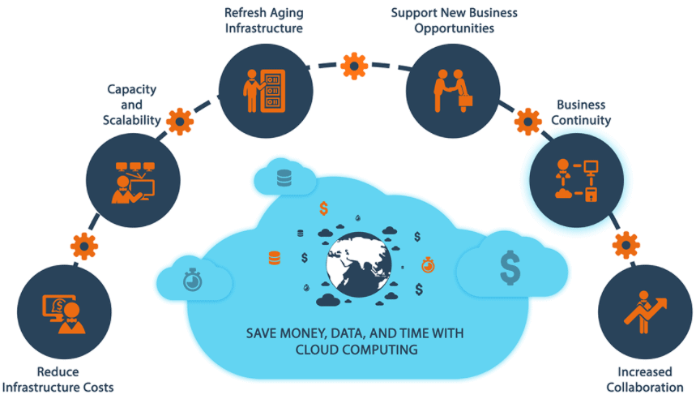

Slide 26
Cloud computing disadvantages

Slide 27
Cloud computing disadvantages
Cloud security
Cloud performance
Limited customization options
Cost unpredictability
Lack of capability and expertise
Compliance with industry laws
Complicated cloud migration
IT governance issues
Vendor lock-in

Slide 28
Cloud security
Security is often considered the greatest challenge facing cloud computing, especially when it comes to sensitive medical records and financial information.
When relying on the cloud, organizations risk
data breaches
hacking of APIs and interfaces
compromised credentials
authentication issues
Furthermore, there is a lack of transparency regarding how and where sensitive information entrusted to the cloud provider is handled.
Security demands careful attention to cloud configurations and business policy and practice.

Slide 29
Cloud performance
Performance -- such as latency -- is largely beyond the control of the organization contracting cloud services with a provider.
Network and provider outages can interfere with productivity and disrupt business processes if organizations are not prepared with contingency plans.

Slide 30
End of review

Slide 31
Limited customization options
Cloud computing is cheaper because of economics of scale, but it offers fewer options at a much cheaper price
A restaurant with a limited menu is cheaper than a personal chef who can cook anything you want

Slide 32
Cost unpredictability
Pay-as-you-go subscription plans for cloud use, along with scaling resources to accommodate fluctuating workload demands, can make it tough to predict final costs

Slide 33
Lack of capability and expertise
With cloud-supporting technologies rapidly advancing, organizations are struggling to keep up with the growing demand for tools and employees with the proper skill sets and knowledge needed to architect, deploy, and manage workloads and data in a cloud.

Slide 34
Compliance with industry laws
When transferring data from on-premises local storage into cloud storage, it can be difficult to manage compliance with industry regulations through a third party.
It's important to know where data and workloads are actually hosted in order to maintain regulatory compliance and proper business governance.

Slide 35
Complicated cloud migration
The process of moving applications and other data to a cloud infrastructure often causes complications
Migration projects frequently take longer than anticipated and go over budget

Slide 36
IT governance issues
Cloud infrastructure is completely owned, managed, and monitored by the service provider, so the cloud users have less control over the function and execution of services within a cloud infrastructure.
This can make it challenging to properly manage risks and security, IT compliance and data quality.

Slide 37
Vendor lock-in
Often, switching between cloud providers can cause significant issues.
technical incompatibilities
legal and regulatory limitations
substantial costs incurred from sizable data migrations

Slide 38
Summary (1)
Cloud computing is the delivery of different services through the Internet
The service types include software, infrastructure, platform and many others
They can be deployed in private clouds and public clouds, as well as their combination

Slide 39
Summary (2)
Cloud computing offers its users many advantages, but it also has disadvantages and there is an ongoing research to solve these problems

Slide 40
Topic 2: Cloud Service Models

Slide 41
Intended learning outcomes
After completing this topic, you will be able to:
Differentiate between different types of cloud service models
Be able to choose the appropriate cloud service model for different needs

Slide 42
Topic (2) Cloud service models
Introduction and evolution of cloud service models
Infrastructure as a Service (IAAS)
Platform as a Service (PAAS)
Software as a Service (SAAS)
More Services (XAAS)
Comparison between different models

Slide 43
Recall our cloud computing definition
Cloud computing is the delivery of different services through the Internet, which includes tools and applications like data storage, servers, databases, networking, and software.

Slide 44
different services available in the cloud
Access to physical servers, virtual servers, storage, networking
Access to platforms for developing, running, maintaining and managing applications
Access to application software

Slide 45
different services available in the cloud
Access to physical servers, virtual servers, storage, networking - Infrastructure
Access to platforms for developing, running, maintaining and managing applications - Platform
Access to application software – Software

Slide 46
Cloud services
Cloud services are infrastructure, platforms, or software that are hosted by third-party providers and made available to users through the internet.

Slide 47
Cloud Service Models
Software as a Service (SaaS)
Platform as a Service (PaaS)
Infrastructure as a Service (IaaS)
SalesForce CRM
LotusLive
Google App Engine

Slide 48
Cloud service models
IaaS
PaaS
SaaS

Slide 49
Cloud service models
IaaS – Infrastructure
PaaS – Platform
SaaS – Software
as a Service

Slide 50
'… as a service’ (1)
refers to the way IT assets are consumed
It also describes the essential difference between cloud computing and traditional IT

Slide 51
'… as a service’ (2)
In traditional IT, an organization consumes IT assets - hardware, system software, development tools, applications - by purchasing them, installing them, managing them and maintaining them in its own on-premises data center.

Slide 52
'… as a service’ (3)
In cloud computing, the cloud service provider owns, manages and maintains the assets; the customer consumes them via an Internet connection, and pays for them on a subscription or pay-as-you-go basis.
There are three main types of as-a-Service solutions:
IaaS
PaaS
SaaS

Slide 53
'… as a service’ (4)
The main advantage of IaaS, PaaS, SaaS or any 'as a service' solution is economic
A customer can access and scale the IT capabilities it needs without the expense and overhead of purchasing and maintaining everything in its own data center.
But there are additional advantages specific to each of these solutions.

Slide 54
IaaS, PaaS, SaaS (1)
IaaS - infrastructure as a service - on-demand access to cloud-hosted physical and virtual servers, storage and networking - the backend IT infrastructure for running applications and workloads in the cloud
PaaS - platform as a service - on-demand access to a complete, ready-to-use, cloud-hosted platform for developing, running, maintaining and managing applications
SaaS - software as a service - on-demand access to ready-to-use, cloud-hosted application software

Slide 55
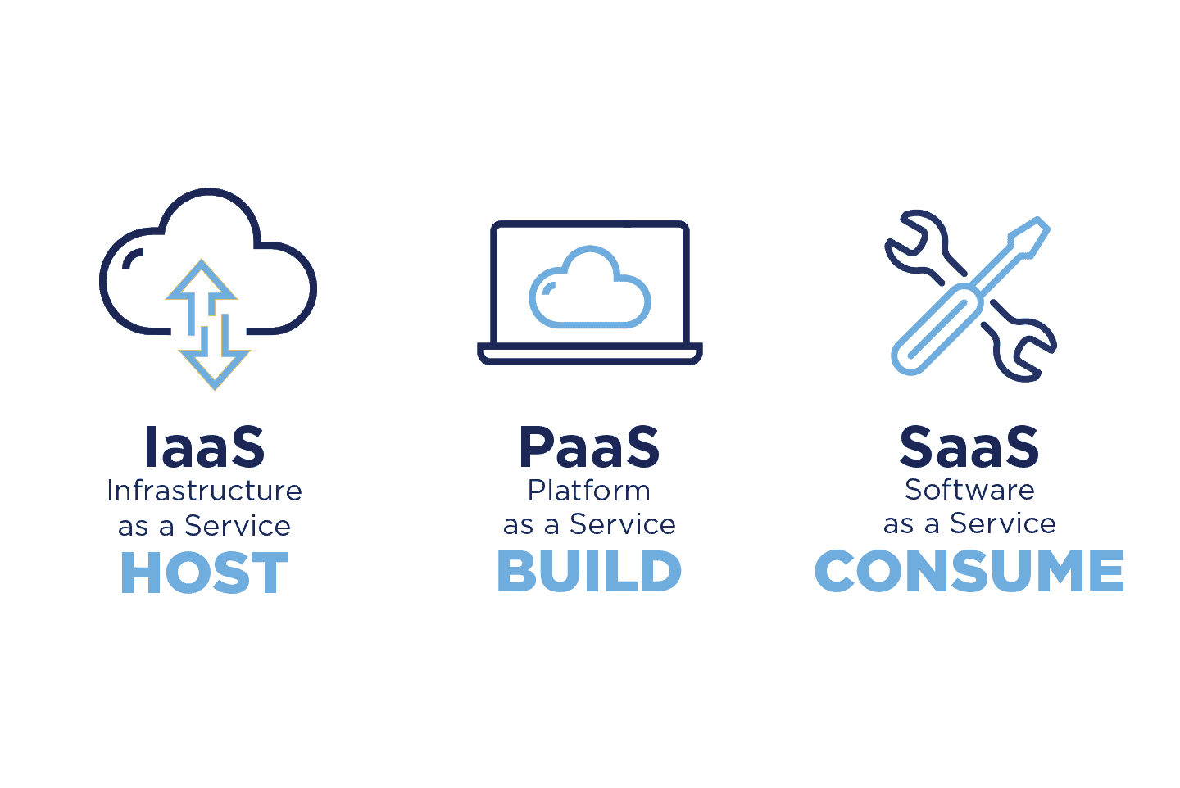

Slide 56
IaaS, PaaS, SaaS (2)
IaaS, PaaS and SaaS are not mutually exclusive. Many mid-sized businesses use more than one, and most large enterprises use all three
Each cloud service comes with its own set of advantages that can cater to various business requirements
We require a clear understanding of these cloud models to find out which one can work the best for specific needs of users
Let us understand each of the models and find out their merits

Slide 57
Evolution of cloud service models
IaaS can be thought of as the original 'as a service' offering
Every major cloud service provider - Amazon Web Services, Google Cloud, IBM Cloud, Microsoft Azure - began by offering some form of IaaS

Slide 58
Infrastructure as a Service (IAAS)

Slide 59
Infrastructure as a Service (IAAS)
The virtual delivery of computing resources in the form of hardware, networking, and storage services
Infrastructure is hosted by third-party providers and made available to users through the internet
Rather than buying and installing the required resources in their own data center, companies rent these resources as needed

Slide 60
What is infrastructure
Servers
Storage capacity
Networking resources

Slide 61
How infrastructure is provided
The cloud service provider hosts, manages and maintains the hardware and computing resources in its own data centers.
Customers can provision, configure and operate the servers and infrastructure resources via a graphical dashboard, or programmatically through application programming interfaces (APIs)
Typically IaaS customers can choose between virtual machines (VMs) hosted on
shared physical hardware
bare metal servers on dedicated (unshared) physical hardware

Slide 62
IaaS characteristics
Users are provided with virtualized hardware and storage on top of which they can build their infrastructure
Dynamic scaling
Self scaling
Alterable cost – utility pricing model
Pay as you go
Ability to provide single hardware to many users
The costs are less due to the share of infrastructure

Slide 63
User activities in IaaS
Configures the infrastructure
Setups the infrastructure
Installs, manages and monitors any required software

Slide 64
Typical level of control granted to cloud user in IaaS
Full administrative

Slide 65
Cloud provider activities in IaaS
Manages and provisions the storage
Physical processing, hosting and networking
Monitors usage by the consumer of cloud

Slide 66
Who manages what in IaaS model
A cloud service provider
manages the infrastructure for the user
The actual servers, network, virtualization, and data storage
has the responsibility of taking care of
Outages
Repairs
Hardware issues
The user
has access through an API or dashboard, and essentially rents the infrastructure
manages things like the operating system, apps, and middleware

Slide 67
Vendors of IaaS
Amazon
Gogrid,
RACKSPACE
IBM BlueHouse
Linode
VMWare

Slide 68
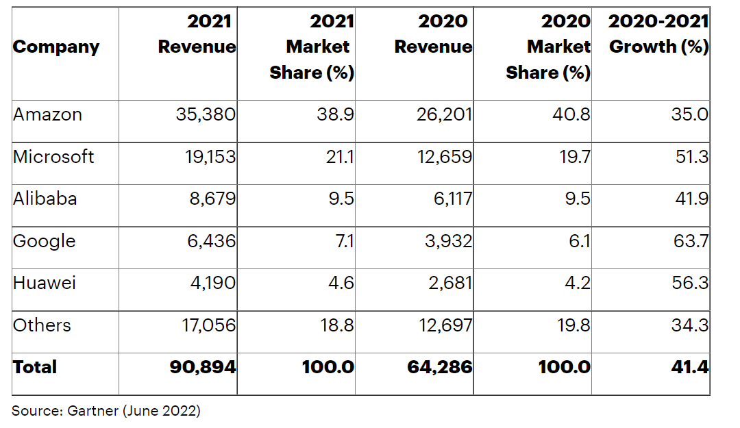
Worldwide IaaS Public Cloud Services Market Share, 2020-2021 (Millions of U.S. Dollars)

Slide 69
IaaS Example - Amazon Web Services
A public cloud that offers subscribers
Access to virtual servers for product deployment
Cloud storage
Tools for development, testing, and analytics
The application provides a ready-to-use environment to develop and test the product and offers the full cloud infrastructure for its deployment and maintenance

Slide 70
AWS Free Usage Tier
Free Amazon EC2 (elastic compute) Micro Instance for a year
Includes free usage tier for:
Amazon S3
Amazon Elastic Block Store
Amazon Elastic Load Balancing
AWS data transfer
Free usage of AWS Management Console to build and manage applications on AWS
AWS’s free usage tier can be used for anything you want to run in the cloud:
Launch new applications
Test existing applications in the cloud
Gain hands-on experience with AWS

Slide 71
AWS Free Usage Tier
Free Amazon EC2 (elastic compute) Micro Instance for a year
Includes free usage tier for:
Amazon S3
Amazon Elastic Block Store
Amazon Elastic Load Balancing
AWS data transfer
Free usage of AWS Management Console to build and manage applications on AWS
AWS’s free usage tier can be used for anything you want to run in the cloud:
Launch new applications
Test existing applications in the cloud
Gain hands-on experience with AWS

Slide 72
Amazon Elastic Compute (EC2) Instances
A virtual server is referred to as an Amazon EC2 instance
Amazon Elastic Compute Cloud (Amazon EC2) is a component of AWS and central to many cloud-based applications
A micro Amazon EC2 instance can be launched in the free usage tier
Micro instances provide a small amount of consistent CPU resources and allow o burst CPU capacity when additional cycles are available (613 MB of memory, up to 2 ECUs (for short periodic bursts), EBS storage only, 32-bit or 64-bit platform)
A micro instance is well suited for lower throughput applications and web sites that consume significant compute cycles only occasionally
To request an Amazon EC2 instance, you use the Request Instances wizard or the Quick Launch wizard to specify an Amazon Machine Image (AMI)
An AMI contains all the information that AWS needs to create the instance
Amazon EC2 instances can also be launched automatically when you deploy a web application using AWS Elastic Beanstalk

Slide 73
Amazon Simple Storage Service (S3)
Amazon S3 is storage for the Internet
Amazon S3 provides a simple web services interface that can be used to store and retrieve any amount of data, at any time, from anywhere on the web
It gives any developer access to the same highly scalable, reliable, secure, fast, inexpensive infrastructure that Amazon uses to run its own global network of web sites
S3 allows to write, read, and delete objects containing from 1 byte to 5 terabytes of data each. The number of objects you can store is unlimited
Each object is stored in a region-specific bucket and retrieved via a unique, developer-assigned key
Data stored in Amazon S3 is secure by default
Only bucket and object owners have access to the Amazon S3 resources they create
Amazon S3 supports multiple access control mechanisms, as well as encryption for both secure transit and secure storage on disk
Typical use cases
Content storage and distribution
Storage for data analysis
Backup, archiving and disaster recovery

Slide 74
IaaS Example - IBM Infrastructure
IBM uses its in-house services to store the data of infrastructure users, enabling remote data access via Cloud computing
IBM servers support AI, blockchain, and the Internet of Things
The infrastructure also provides Cloud storage and virtual development environments, enabled on the subscription basis

Slide 75
IaaS Example - Google Cloud Infrastructure
A large network of international servers that provides users access to remote Cloud data centers.
Companies can store their information in Asia, Europe, Latin America, which minimizes the risk of a security breach

Slide 76
IaaS use cases (1)
Disaster recovery
Instead of setting up redundant servers in multiple locations, IaaS can deploy its disaster recovery solution to the cloud provider's existing geographically-dispersed infrastructure

Slide 77
IaaS use cases (2)
E-commerce
IaaS is an excellent option for online retailers that frequently see spikes in traffic
The ability to scale up during periods of high demand and high-quality security are essential in today’s 24-7 retail industry

Slide 78
IaaS use cases (3)
Applications that work with huge volumes of data
Internet of Things (IoT)
event processing
artificial intelligence (AI)
IaaS makes it easier to set up and scale up data storage and computing resources

Slide 79
IaaS use cases (4)
Startups
Startups can't afford to sink capital into on-premises IT infrastructure
IaaS gives them access to enterprise-class data center capabilities without the up-front investment in hardware and management overhead

Slide 80
IaaS use cases (5)
Software development
With IaaS, the infrastructure for testing and development environments can be set up much more quickly than on-premises.
However, this use case is better suited to PaaS

Slide 81
Discussion
Suppose a large organization wants to deliver a customer relationship management (CRM) application to its sales team.
CRM software connects all the data from sales leads and customers. It consolidates all communications (form fills, calls, emails, text messages, and meetings), documents, quotes, purchases, and tasks associated with each lead and client.
Can they choose an IaaS model?

Slide 82

1 answer(s) at most
Suppose a large organization wants to deliver a customer relationship management (CRM) application to its sales team.
(*) CRM software connects all the data from sales leads and customers. It consolidates all communications (form fills, calls, emails, text messages, and meetings), documents, quotes, purchases, and tasks associated with each lead and client.
Can they choose an IaaS model?
A
YES
B
NO
Submit

Slide 83
Multiple Choice(single)
Points: 1
Suppose a large organization wants to deliver a customer relationship management (CRM) application to its sales team.
(*) CRM software connects all the data from sales leads and customers. It consolidates all communications (form fills, calls, emails, text messages, and meetings), documents, quotes, purchases, and tasks associated with each lead and client.
Can they choose an IaaS model?
A
YES
B
NO
Submit

Slide 84
Discussion
If the company chooses an IaaS model,
what will be their own responsibility?
what will be provided by the cloud provider?

Slide 85
Open Question
Points: 10
If the company chooses an IaaS model, what will be their own responsibility and what will be provided by the cloud provider?
Open Question is only supported on Version 2.0 or newer.
Answer

Slide 86
Answer
They can build out backend IT infrastructure on the cloud using IaaS, and use it to build its own development platform and application.
The organization's IT team would have complete control over operating systems and server configurations, but also bear the burden of managing and maintaining them, along with the development platform and applications that run on them.

Slide 87
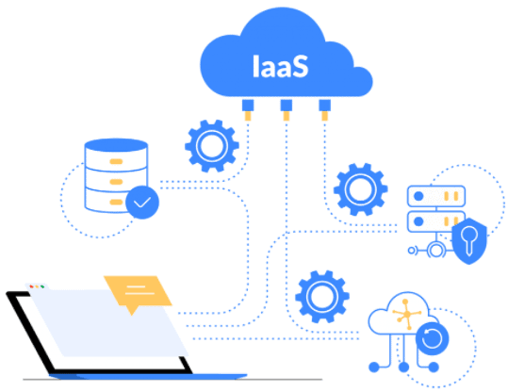

Slide 88
Platform as a Service (PAAS)

Slide 89
Platform as a Service (PAAS) - 1
Platform as a Service is software that provides access to development tools, APIs, and deployment instruments
Users receive access to virtual development environments and Cloud storage, where they can build, test, and run applications.

Slide 90
Platform as a Service (PAAS)
Platform as a Service is software that provides access to development tools, APIs, and deployment instruments
Users receive access to virtual development environments and Cloud storage, where they can build, test, and run applications.

Slide 91
Platform as a Service (PAAS) - 2
Platform is hosted by third-party providers and made available to users through the internet
PaaS providers host the hardware and software on their infrastructure, thereby releasing customers from any obligation to install in-house hardware and software to develop or run a new application

Slide 92
Platform as a Service (PAAS) - 3
The consumer does not manage or control the underlying cloud infrastructure including network, servers, operating systems, or storage
The consumer has control over the deployed applications and possibly configuration settings for the application-hosting environment

Slide 93
What is platform
Cloud-based platform for developing, running, managing applications
hardware and software
servers for development, testing and deployment
operating system (OS) software
storage, networking, databases, middleware, runtimes, frameworks,
development tools
…

Slide 94
What is platform
Cloud-based platform for developing, running, managing applications
hardware and software
servers for development, testing and deployment
operating system (OS) software
storage, networking, databases, middleware, runtimes, frameworks,
development tools
…

Slide 95
How is platform provided
PaaS provides a virtual runtime environment through which users can acquire space to develop and test various applications.
The cloud services provider hosts, manages and maintains all the hardware and software included in the platform as well as related services for security, operating system and software upgrades, backups and more.
Users access the PaaS through a graphical user interface (GUI), where development teams can collaborate on all their work across the entire application lifecycle including coding, integration, testing, delivery, deployment, and feedback.

Slide 96
PaaS characteristics
Users are provided with a platform for developing applications hosted in the Cloud
Services to develop, test, deploy, host and maintain applications
Users can use Web based user interface creation tools help to modify, create, deploy and test different UI scenarios
Same development application could be utilized by many users
Support for development team collaboration
Tools available to handle billing and subscription management
It consumes cloud infrastructure

Slide 97
User activities in PaaS
Tests cloud based solutions and cloud services
Develops cloud based solutions and cloud services
Manages cloud based solutions and cloud services
Deploys cloud based solutions and cloud services

Slide 98
Typical level of control granted to cloud user in PaaS
Limited administrative

Slide 99
Cloud provider activities in PaaS
Pre-configure platform
Provision underlying infrastructure, middleware and other required IT resources
Monitor usage by a consumer of the cloud

Slide 100
Who manages what in PaaS model
PaaS means the hardware and an application-software platform are provided and managed by an outside cloud service provider
The user handles the apps running on top of the platform and the data the app relies on.

Slide 101
Vendors of PaaS
Google AppEngine
Microsoft Azure
Amazon AWS Elastic Beanstalk
Yahoo developer Network
…

Slide 102
PaaS examples - AWS Elastic Beanstalk
A web platform for software deployment and management, powered by the AWS Cloud
Users upload their applications to the service, and it automatically monitors the performance, load capacity, and checks for deployment errors

Slide 103
PaaS examples - Apache Stratos
The Cloud computing platform that helps run Apache Tomcat, PHP, and MySQL applications
It can be extended to support many more environments on all major cloud infrastructures.
It provides users with ready-to-use tools for database development and testing, performance monitoring, integration, and billing.

Slide 104
PaaS use cases (1)
API development and management
With its built-in frameworks, PaaS makes it easier for teams to develop, run, manage and secure APIs for sharing data and functionality between applications.
API - Application Programming Interface
mechanisms that enable two software components to communicate with each other using a set of definitions and protocols
Example
the weather bureau’s software system contains daily weather data
the weather app on your phone “talks” to this system via APIs and shows you daily weather updates on your phone

Slide 105
PaaS use cases (2)
Internet of Things (IoT)
PaaS supports a range of programming languages (Java, Python, Swift, etc.), tools and application environments used for IoT application development and real-time processing of data from IoT devices.
IoT
the network of physical objects—“things”—that are embedded with sensors, software, and other technologies for the purpose of connecting and exchanging data with other devices and systems over the internet
These devices range from ordinary household objects to sophisticated industrial tools.

Slide 106
PaaS use cases (3)
Agile development and DevOps
PaaS solutions typically cover all the requirements of a DevOps toolchain, and provide built-in automation to support continuous integration and continuous delivery (CI/CD).
DevOps
a set of practices that combines software development and IT operations
It aims to shorten the systems development life cycle and provide continuous delivery with high software quality. DevOps is complementary with Agile software development

Slide 107
PaaS use cases (4)
Cloud-native development and hybrid cloud strategy
PaaS solutions support cloud-native development technologies - microservices, containers, Kubernetes, serverless computing
A cloud-native application is a program that is designed for a cloud computing architecture

Slide 108
Discussion
Suppose a large organization wants to deliver a customer relationship management (CRM) application to its sales team.
CRM software connects all the data from sales leads and customers. It consolidates all communications (form fills, calls, emails, text messages, and meetings), documents, quotes, purchases, and tasks associated with each lead and client.
Can they choose a PaaS model?

Slide 109
1 answer(s) at most
Suppose a large organization wants to deliver a customer relationship management (CRM) application to its sales team.
(*) CRM software connects all the data from sales leads and customers. It consolidates all communications (form fills, calls, emails, text messages, and meetings), documents, quotes, purchases, and tasks associated with each lead and client.
Can they choose a PaaS model?
A
YES
B
NO
Submit

Slide 110
Multiple Choice(single)
Points: 1
Suppose a large organization wants to deliver a customer relationship management (CRM) application to its sales team.
(*) CRM software connects all the data from sales leads and customers. It consolidates all communications (form fills, calls, emails, text messages, and meetings), documents, quotes, purchases, and tasks associated with each lead and client.
Can they choose a PaaS model?
A
YES
B
NO
Submit

Slide 111
Discussion
If the company chooses a PaaS model,
what will be their own responsibility?
what will be provided by the cloud provider?

Slide 112
Open Question
Points: 10
If the company chooses a PaaS model, what will be their own responsibility and what will be provided by the cloud provider?
Open Question is only supported on Version 2.0 or newer.
Answer

Slide 113
Answer
They can choose a PaaS solution and build a custom CRM application using the platform provided in the cloud.
The company would offload management of infrastructure and application development resources to the cloud service provider.
The customer would retain complete control over application features, but it would also assume responsibility for managing the application and associated data.

Slide 114
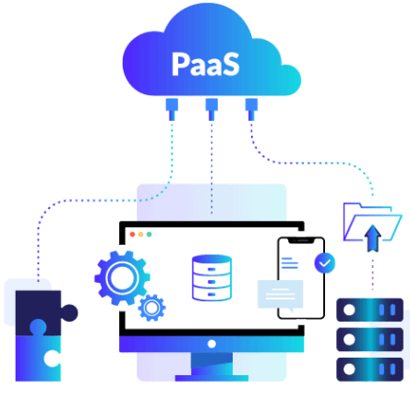

Slide 115
Software as a Service (SAAS)

Slide 116
Software as a Service (SAAS)
Software is hosted by third-party providers and made available to users through the internet
(SaaS) is a software licensing and delivery model
A web platform that provides users access to cloud computing on a subscription basis
Instead of purchasing the solution one time, as if it would be a product, the software is delivered continuously — like a service.

Slide 117
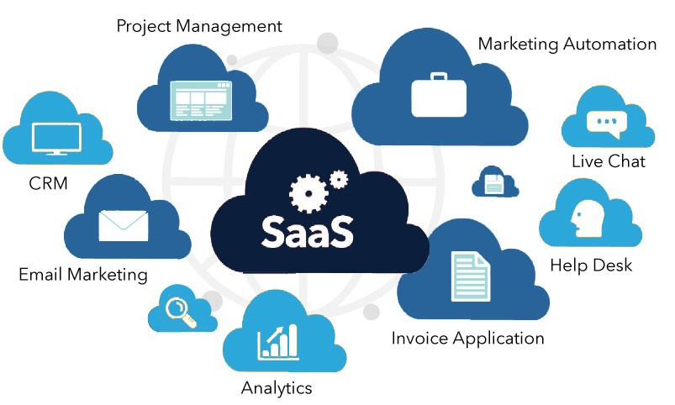
What is software
web applications or mobile apps that users can access via a web browser

Slide 118
How is software provided
SaaS is a service that delivers a software application—which the cloud service provider manages—to its users
Software updates, bug fixes, and other general software maintenance are taken care of for the user
SaaS apps are web applications or mobile apps that users can access via a web browser
Users connect to the cloud applications via a dashboard or API
SaaS eliminates the need to have an app installed locally on each individual user’s computer
allowing team access to the software

Slide 119
SaaS characteristics
Centralized Hosting /Delivery
Users are provided with applications that are accessible anytime and from anywhere
These applications are provided in one-to-many mechanism
UI powered by “thin client” applications
SLA – Service Level Agreement
Stateless
Loosely coupled
Modular

Slide 120
User activities in SaaS
Uses cloud service
Configures cloud service

Slide 121
Typical level of control granted to cloud user in SaaS
Usage
Usage-related configuration

Slide 122
Cloud provider activities in SaaS
Manage, maintain and implement cloud service
Monitor usage by the consumer of cloud

Slide 123
Who manages what in SaaS model
The application and all of the infrastructure required to deliver it - servers, storage, networking, middleware, application software, data storage - are hosted and managed by the SaaS vendor
The vendor also manages all upgrades and patches to the software, usually invisibly to customers
Customers can add more users and data storage on demand at additional cost

Slide 124
Vendors of SaaS
Salesforce.com,
Microsoft Office 365
Google documents,
Clarizen.com,
Gmail,
Hotmail,
Quicken online,
Netsuite,

Slide 125
Examples of SaaS - Microsoft Office 365
The series of web services that provide business owners and individuals with access to Microsoft Office main tools directly from their browsers
Users can access Microsoft editing tools, business email, communication instruments, and documentation software

Slide 126
Examples of SaaS - Salesforce
The most popular CRM on the market that unites marketing, communication, e-commerce
Business owners can keep track of their sales, client relations, communications, and relevant tasks from any device
Salesforce can be integrated into the website — the information about incoming leads will be sent to the platform automatically

Slide 127
SaaS use cases (1)
Today, just about any personal or employee productivity application is available as SaaS
If an end user or organization can find a SaaS solution with the required functionality, in most cases it will provide a significantly simpler, more scalable and more cost-effective alternative to on-premises software.
Many applications designed originally for the desktop (e.g., Adobe Creative Suite) are now available as SaaS (e.g., Adobe Creative Cloud).

Slide 128
SaaS use cases (2)
SaaS applications people use every day in their personal lives
email
social media
cloud file storage solutions
…

Slide 129
SaaS use cases (3)
Business or enterprise SaaS solutions
customer relationship management software
marketing software
workflow management
collaboration and messaging
graphics
…

Slide 130
Discussion
Suppose a large organization wants to deliver a customer relationship management (CRM) application to its sales team.
CRM software connects all the data from sales leads and customers. It consolidates all communications (form fills, calls, emails, text messages, and meetings), documents, quotes, purchases, and tasks associated with each lead and client.
Can they choose a SaaS model?

Slide 131
1 answer(s) at most
Suppose a large organization wants to deliver a customer relationship management (CRM) application to its sales team.
(*) CRM software connects all the data from sales leads and customers. It consolidates all communications (form fills, calls, emails, text messages, and meetings), documents, quotes, purchases, and tasks associated with each lead and client.
Can they choose a SaaS model?
A
YES
B
NO
Submit

Slide 132
Multiple Choice(single)
Points: 1
Suppose a large organization wants to deliver a customer relationship management (CRM) application to its sales team.
(*) CRM software connects all the data from sales leads and customers. It consolidates all communications (form fills, calls, emails, text messages, and meetings), documents, quotes, purchases, and tasks associated with each lead and client.
Can they choose a SaaS model?
A
YES
B
NO
Submit

Slide 133
Discussion
If the company chooses a SaaS model,
what will be their own responsibility?
what will be provided by the cloud provider?

Slide 134
Open Question
Points: 10
If the company chooses a SaaS model, what will be their own responsibility and what will be provided by the cloud provider?
Open Question is only supported on Version 2.0 or newer.
Answer

Slide 135
Answer
They can choose a SaaS CRM solution, offloading all day-to-day management to the third-party vendor, but also giving up all control over features and functionality, data storage, user access and security.

Slide 136
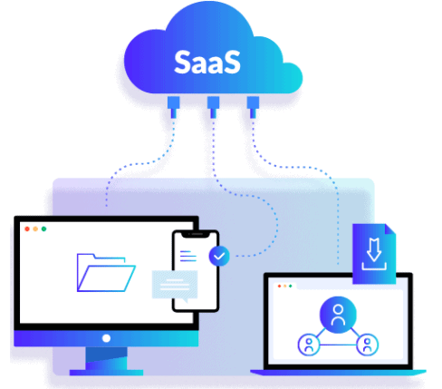

Slide 137
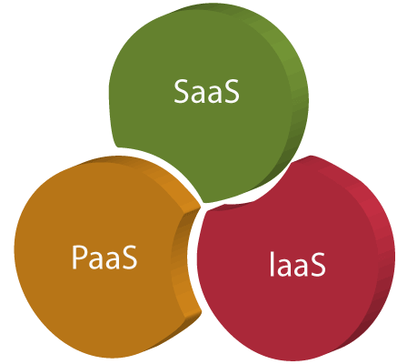
… as a service

